Slide 1
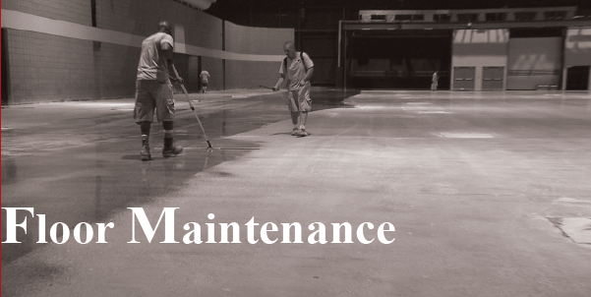

Lythic SOLUTIONS™ Colloidal Silica Nano Technology
Floor Cleaning - Lythic™ Cleaner

Slide 2
WHAT IS COLLOIDAL SILICA?
Reactive Colloidal Silica –Reactive Colloidal Silica is 99.5% pure nano-sized silica particles suspended in an ultra-low surface tension liquid
(A “colloid” is a suspension of solid particles in a liquid; the solids are not dissolved, but they do not sink to the bottom and separate, either, due to a special process.)
These Nano Sized Silica Particles, in there low-viscosity suspension penetrate quickly, deeply, and cleanly into concrete.
React very efficiently with lime in concrete.
These reactions form cementitious compounds in the concrete’s pores that harden and densify the surface with less wait and less waste.

Slide 3
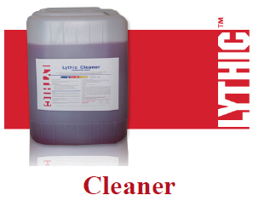
Lythic™ Cleaner
Product Description
Lythic Cleaner is a non-corrosive cleaner, formulated to remove surface dirt and soil from concrete floor surfaces. It fortifies concrete surfaces with reactive silica as it cleans to increase durability and maintain surface polish.
Adds Reactive Colloidal Silica to the surface as it cleans which bonds to concrete naturally, so every cleaning improves resistance to abrasion and liquid penetration.

Slide 4
Direction for use
Cleaning
If the main goals of the cleaning program are achieved, your floor should last for the life of the buiding.
Sweeping or dry mopping a floor will remove abrasives such as dirt and debris. Always sweep before using your autoscrubber to scrub the floor.
Autoscrubber
Dilute Lythic Cleaner with water in your autoscrubber.
  Dilute the Cleaner 4oz (1:32) per gallon of water. In an autoscrubber this should achieve about 1000ft2 per gallon of water.
  Dilute stronger up to 8oz (1:16) per gallon of water for heavy soiled areas
Allow the product to dwell before extraction will increase cleaner efficiency.
Mop cleaning will be effective if done using a separate rinse bucket. The rinse water needs frequent changing.

Slide 5
Application Areas
Industrial & Warehouse Floors
Commercial Floors
Retail Outlets
Mr. Pradeep Lamba :+91 9717854400
LTFSPL@gmail.com
Mr. Ritesh Jain : +91 8470854405
riteshjain@Ltfsolutions.co.in
Visit Us: WWW.LTFSOLUTIONS.CO.IN

